Slide 1
Book Recommendation Platform – Project Demo
Lakshmi Narayana Manukonda
Professional Seminar
COMP-699-B.FA25
Prof. David Pitts & Prof. Vladimir Riabov
Rivier University
December 3rd, 2025
1

Slide 2
Introduction
Huge book lists make finding a good next read slow and guessy.
My app loads your CSV/XLSX, maps columns, and builds a searchable index.
Smart suggestions use TF-IDF + cosine similarity (by profile, title, or keyword).
Simple filters (title, author, language, genre, difficulty) + fast results.
Track To-Read/Completed with a live progress chart; all data stays local.
2

Slide 3
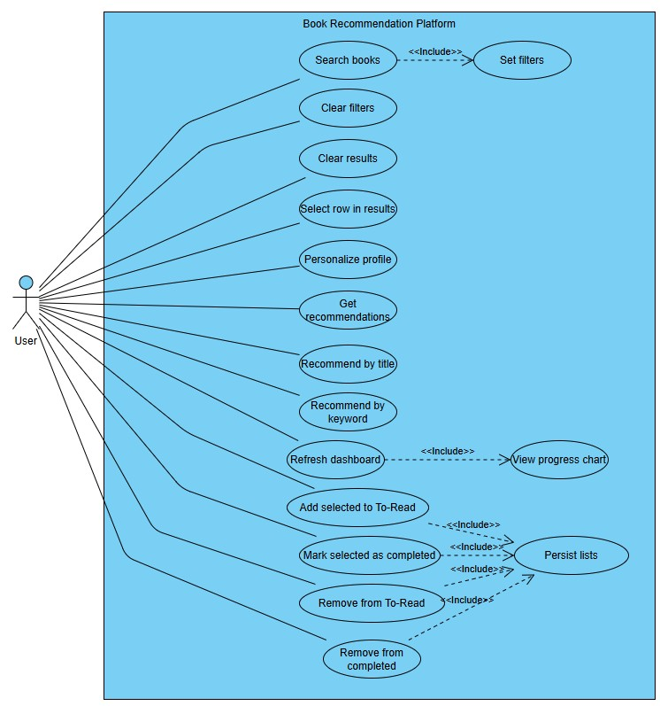
Usecase diagram
3

Slide 4
Usecase diagram explanation
One User interacts with the desktop app to find and manage books.
Search books with Set filters (title, author, language, genre, difficulty) to see results.
Personalize profile and Get recommendations powered by similarity scoring.
Quick discovery via Recommend by title and Recommend by keyword.
Manage reading: Add to To-Read, Mark as Completed, Remove — changes persist to local state.
Refresh dashboard to view progress chart (To-Read vs Completed).
4

Slide 5
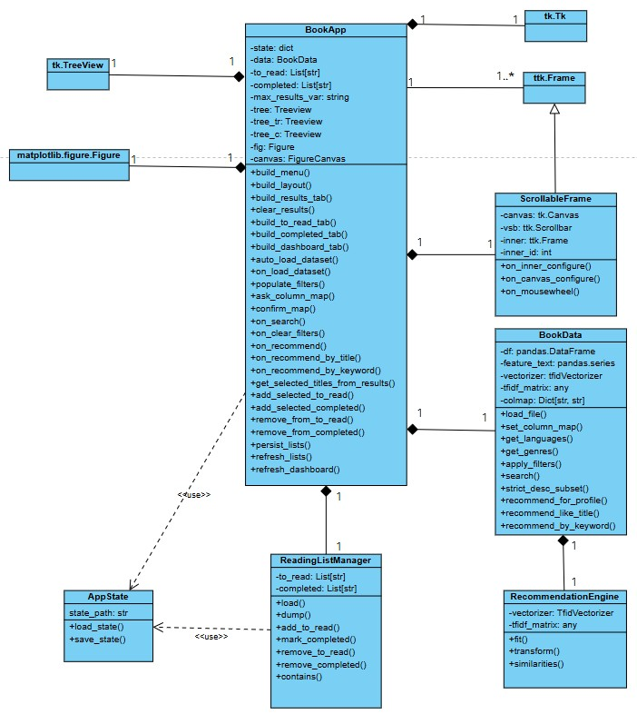
Class Diagram
5

Slide 6
Class diagram explanation
BookApp is the main window: builds menu, sidebar, tabs, handles clicks, and shows results & charts.
BookData loads the CSV/XLSX, maps columns, builds TF-IDF, and provides search/recommend methods.
ScrollableFrame is a reusable scrollable sidebar (Canvas + Scrollbar) used by BookApp.
UI widgets: Treeview lists results/to-read/completed; Matplotlib Figure/Canvas draws the progress chart.
State/persistence: simple JSON save/load for to_read and completed (AppState/ReadingListManager concept).
Relationships: BookApp aggregates UI widgets and uses one BookData; helpers are used (not subclassed) to keep UI, data, and storage separate.
6

Slide 7
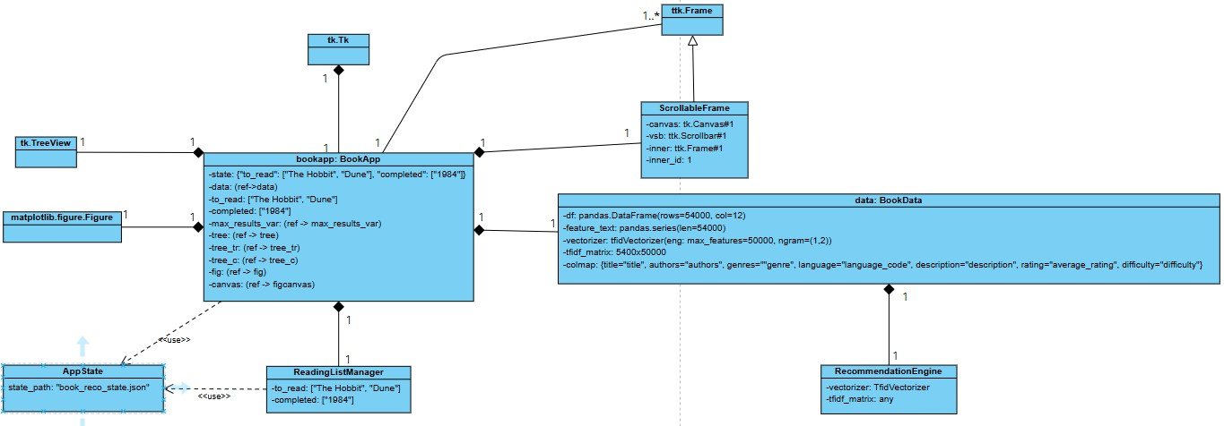
Object Diagram
7

Slide 8
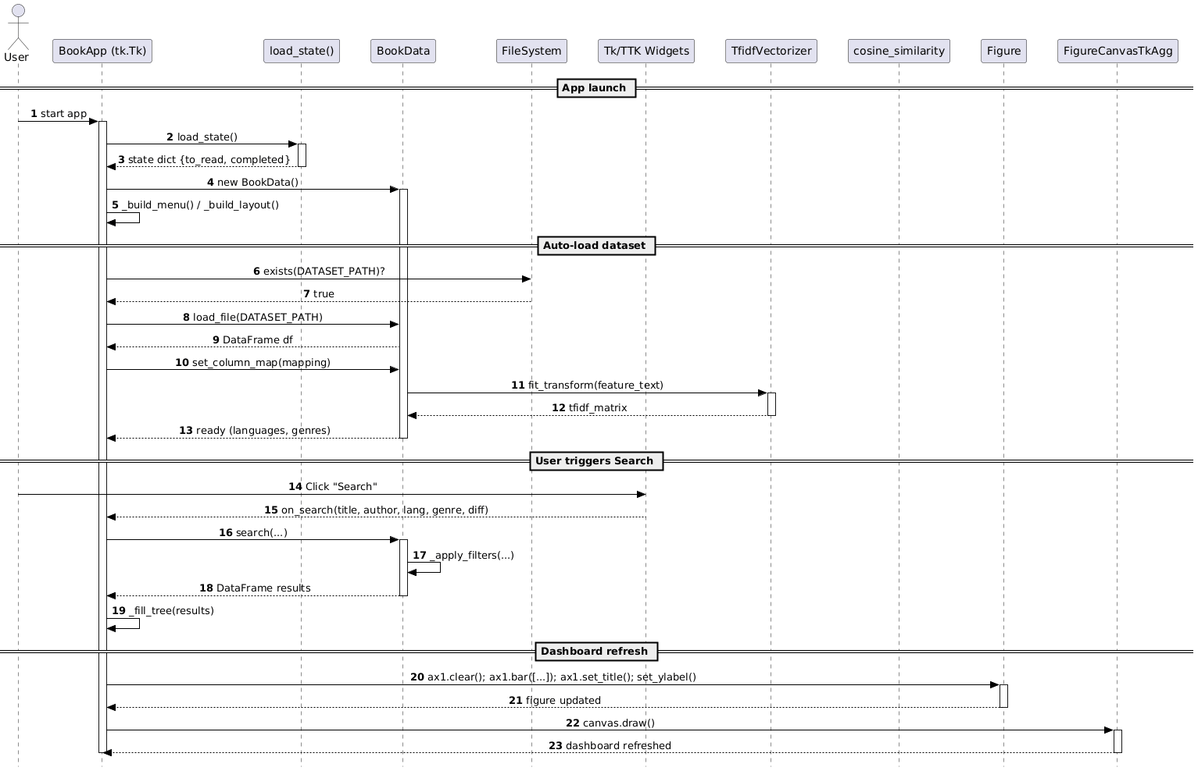
Sequence Diagram
8

Slide 9
Sequence diagram explanation
On launch, BookApp loads saved state (to-read/completed), creates BookData, and builds the menu/layout.
It auto-checks the dataset path, loads the CSV/XLSX, maps columns, and fits TF-IDF to build a search index.
Filters (languages, genres) are populated and the UI is ready.
When the user clicks Search, BookApp calls search(...); BookData applies filters and returns a DataFrame of matches.
BookApp fills the results table with titles/authors/language/rating and shows scores when present.
On updates, the Dashboard clears and redraws the bar chart (to-read vs completed) and refreshes the canvas.
9

Slide 10
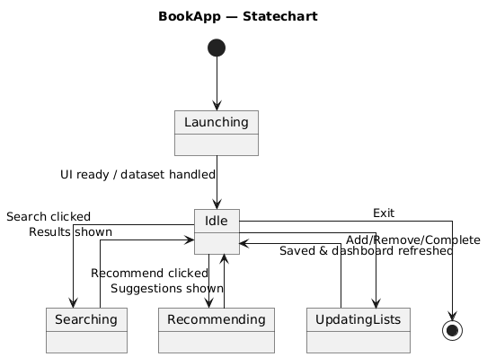
State-Chart Diagram
10

Slide 11
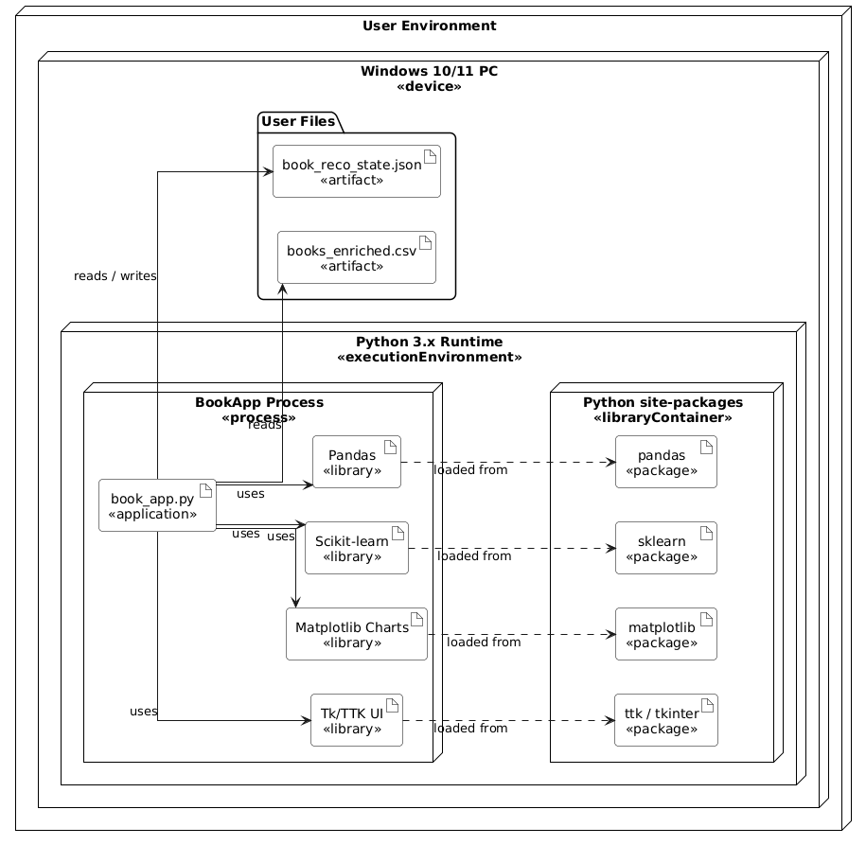
Deployment Diagram
11

Slide 12
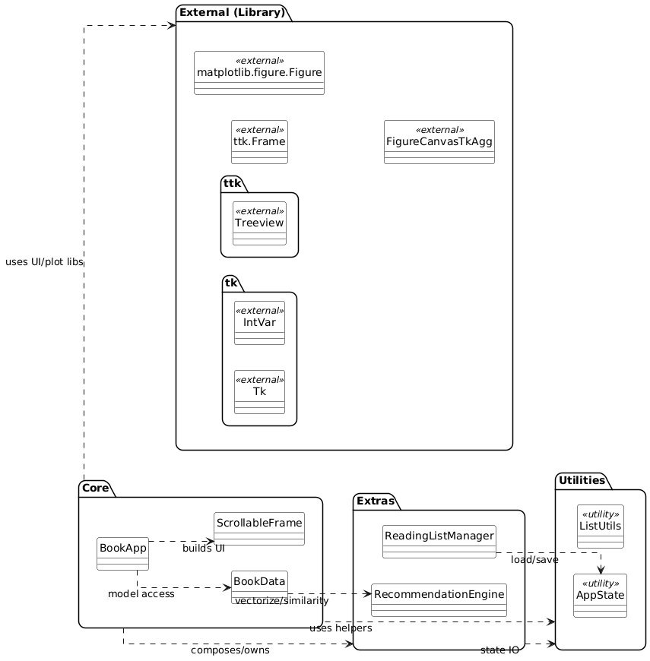
Package Diagram
12

Slide 13
Sequence diagram explanation
Layers: The app is split into Core, Extras, Utilities, and External (library) packages to keep UI, logic, and helpers cleanly separated.
Core: BookApp builds the UI (with ScrollableFrame) and accesses data through BookData. This is the main orchestrator layer.
Extras: RecommendationEngine provides TF-IDF + similarity services that BookData calls; ReadingListManager handles To-Read/Completed list operations.
Utilities: AppState (and ListUtils) handle load/save of JSON state and small list helpers, keeping persistence out of the UI.
External libs: Tk/Ttk widgets (Tk, Frame, Treeview, IntVar) and Matplotlib (Figure, FigureCanvasTkAgg) are used only through BookApp/UI code; domain logic doesn’t depend on them.
Dependencies: One-way arrows: BookApp → BookData → RecommendationEngine, and BookApp → AppState for state I/O. This avoids cycles and makes testing and maintenance easier.
13

Slide 14
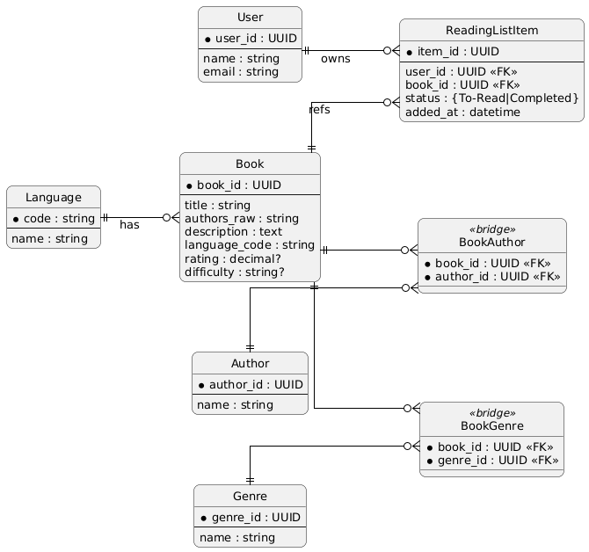
ER Diagram
14

Slide 15
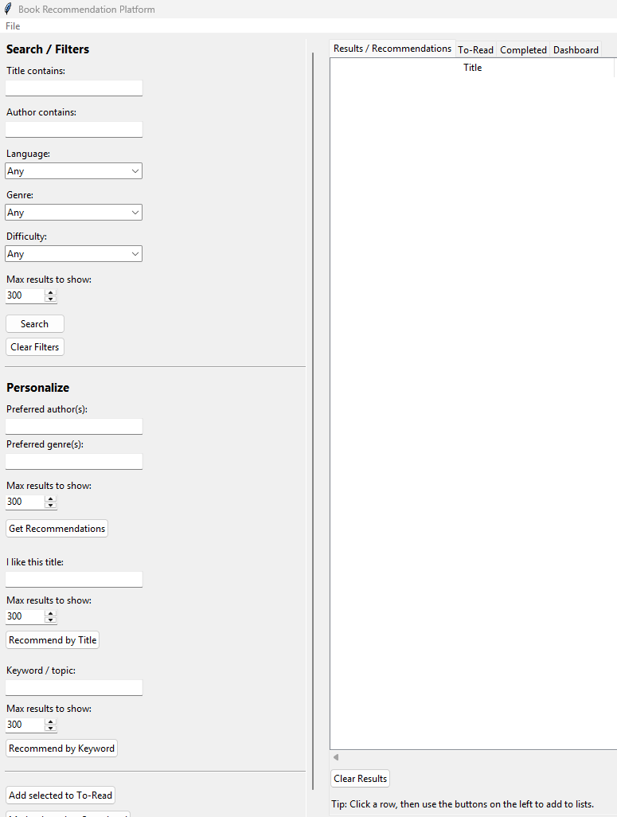
Draft of User Interface
15

Slide 16
Demo
16

Slide 17
Code Walk-through
17

Slide 18
1. Functional Requirements ↔ Code
Functional Requirement (FR) | How it appears in your project | Code elements that implement it
FR1 – Load a books dataset from file | User can load the enriched CSV/XLSX file and the app indexes it for search/recommendations. | BookData.load_file(), BookData.set_column_map(), BookApp._auto_load_dataset(), BookApp.on_load_dataset(), BookApp.ask_column_map(), _confirm_map()
FR2 – Search books using filters | User searches by title, author, language, genre, difficulty. | UI widgets in _build_layout() (title_var, author_var, lang_cb, genre_cb, diff_cb), handler BookApp.on_search(), data logic BookData.search() + _apply_filters()
FR3 – Set and clear filters | User adjusts filter comboboxes / text fields and can reset them. | Filter widgets in _build_layout(), BookApp._populate_filters() (fills choices), BookApp.on_clear_filters()
FR4 – View search / recommendation results | Results grid shows title, author, language, rating, difficulty, score. | Results tab built in _build_results_tab(), self.tree (ttk.Treeview), BookApp._fill_tree()
FR5 – Personalize profile / store preferences for recommendations | User can specify preferred authors and genres. | pref_author, pref_genre controls in _build_layout(), handler BookApp.on_recommend(), BookData.recommend_for_profile()
FR6 – Get content-based recommendations | System recommends books similar to profile, a title, or a keyword/topic. | BookData.feature_text, TfidfVectorizer, self.tfidf_matrix, BookData.recommend_for_profile(), recommend_like_title(), recommend_by_keyword(), cosine similarity from sklearn.metrics.pairwise
FR7 – Recommend by title | User enters a liked title and gets similar books. | UI part “I like this title” in _build_layout(), handler BookApp.on_recommend_by_title(), BookData.recommend_like_title()
FR8 – Recommend by keyword / topic | User enters topic words and gets matching books. | UI part “Keyword / topic” in _build_layout(), handler BookApp.on_recommend_by_keyword(), BookData.recommend_by_keyword()
FR9 – Maintain a To-Read list | User can add selected results to a To-Read list and view/remove them. | List BookApp.to_read, handler add_selected_to_read(), To-Read tab built in _build_to_read_tab(), removal in remove_from_to_read(), view update in refresh_lists()
FR10 – Maintain a Completed list | User can mark books as completed and view/remove them. | List BookApp.completed, handler add_selected_completed(), Completed tab _build_completed_tab(), remove_from_completed(), refresh_lists()
FR11 – Persist reading lists between sessions | To-Read and Completed survive closing/reopening the app. | JSON file APP_STATE_PATH, helpers load_state(), save_state(), BookApp.state, BookApp.persist_lists()
FR12 – View reading progress dashboard | User sees counts of To-Read vs Completed as a bar chart. | Dashboard tab _build_dashboard_tab(), matplotlib Figure + FigureCanvasTkAgg, logic BookApp.refresh_dashboard()
FR13 – Scrollable sidebar UI | Left panel must remain usable even with many controls (usability requirement). | ScrollableFrame class wrapping a tk.Canvas + ttk.Scrollbar, used in _build_layout()
FR14 – Basic error feedback to the user | User gets messages when dataset is missing, mapping fails, or no results. | messagebox.showwarning(), showerror(), showinfo() calls inside _auto_load_dataset(), on_load_dataset(), on_search(), on_recommend*()
18

Slide 19
2. Use Cases ↔ Code
Use Case (UC) | Diagram notes | Code that realizes it
UC1 – Search books | Includes Set filters; triggered by “Search” button. | Button in _build_layout() → BookApp.on_search() → BookData.search() → results shown by _fill_tree() in the Results tab.
UC2 – Set filters | Language, Genre, Difficulty, Title/Author contains. | Combobox/text widgets (self.lang_cb, self.genre_cb, self.diff_cb, self.title_var, self.author_var) built in _build_layout(), values populated by _populate_filters(), filter logic in BookData._apply_filters().
UC3 – Clear filters | Separate button in diagram. | Button “Clear Filters” in _build_layout() → BookApp.on_clear_filters() (resets variables and calls clear_results()).
UC4 – Clear results | Separate oval in diagram. | BookApp.clear_results() (removes all children from self.tree), triggered by the “Clear Results” button in _build_results_tab(), and implicitly inside _fill_tree().
UC5 – Select row in results | Precondition for list operations. | User selects rows in self.tree (ttk.Treeview); BookApp.get_selected_titles_from_results() reads those selections for add/complete operations.
UC6 – Personalize profile | Enter preferred author/genre. | Controls pref_author, pref_genre in _build_layout(). Their values are concatenated into profile inside on_recommend().
UC7 – Get recommendations | Uses profile + filters. | Button “Get Recommendations” → on_recommend() → BookData.recommend_for_profile() → _fill_tree() shows ranked list.
UC8 – Recommend by title | Oval “Recommend by title”. | UI field like_title_var + “Recommend by Title” button → on_recommend_by_title() → BookData.recommend_like_title().
UC9 – Recommend by keyword | Oval “Recommend by keyword”. | UI field keyword_var + “Recommend by Keyword” button → on_recommend_by_keyword() → BookData.recommend_by_keyword().
UC10 – Add selected to To-Read | Moves selected result into To-Read list. | Button “Add selected to To-Read” in _build_layout() → add_selected_to_read() uses get_selected_titles_from_results(), updates self.to_read, then persist_lists() and refresh_lists().
UC11 – Mark selected as completed | Includes Persist lists. | Button “Mark selected as Completed” → add_selected_completed() (moves from to_read to completed), then persist_lists() and refresh_lists().
UC12 – Remove from To-Read | Includes Persist lists. | Button in To-Read tab (_build_to_read_tab()) → remove_from_to_read().
UC13 – Remove from completed | Includes Persist lists. | Button in Completed tab (_build_completed_tab()) → remove_from_completed().
UC14 – Persist lists (<<include>>) | Included by all list-changing UCs. | Centralized in BookApp.persist_lists() → save_state(self.state) which writes book_reco_state.json.
UC15 – Refresh dashboard | Includes View progress chart. | Button “Refresh Dashboard” in _build_dashboard_tab() → BookApp.refresh_dashboard() (rebuilds matplotlib chart).
UC16 – View progress chart (<<include>>) | Displays To-Read vs Completed counts. | Chart drawn in refresh_dashboard() (uses self.ax1.bar(...), self.canvas.draw()).
UC17 – Load dataset | File menu action. | Menu item in _build_menu() → BookApp.on_load_dataset() → BookData.load_file() + set_column_map() or ask_column_map().
UC18 – Auto-load dataset at startup | “Auto-load dataset” fragment in sequence diagram. | BookApp.__init__() calls _auto_load_dataset(), which uses DATASET_PATH.
19

Slide 20
3. Classes / Objects ↔ Code
Diagram Class / Concept | Where it appears in code | Role / Relationship
BookApp (core app/controller) | class BookApp(tk.Tk) | Main window and controller; owns BookData, manages UI, handles all use cases; appears as bookapp:BookApp in the object diagram; lifeline “BookApp (tk.Tk)” in sequence + central state in the statechart.
BookData (data/model) | class BookData | Wraps the DataFrame loaded from books_enriched.csv; responsible for filtering and computing recommendations. Combines responsibilities of BookData + RecommendationEngine from the class diagram.
RecommendationEngine | Not a separate class in code; merged into BookData. | Implemented by feature_text, vectorizer, tfidf_matrix, and methods recommend_for_profile(), recommend_like_title(), recommend_by_keyword().
AppState | Implemented as top-level load_state() / save_state() and BookApp.state dict. | Manages reading list persistence in book_reco_state.json. In the class diagram, BookApp uses AppState; in deployment, this is the JSON artifact.
ReadingListManager | Responsibilities implemented inside BookApp. | Lists to_read, completed + methods add_selected_to_read(), add_selected_completed(), remove_from_to_read(), remove_from_completed(), refresh_lists(), persist_lists().
ScrollableFrame | class ScrollableFrame(ttk.Frame) | Utility widget for the scrollable sidebar; aggregates tk.Canvas, ttk.Scrollbar, and inner ttk.Frame. Shown as ScrollableFrame in the class diagram (composition from BookApp).
User (actor) | Not a code class; external user in diagrams. | Interacts via mouse/keyboard with the Tkinter GUI (buttons, entries, comboboxes, treeviews) implemented inside BookApp._build_layout() and tab builders.
Book / Author / Genre / Language (ER) | Represented by columns / derived columns in BookData.df. | set_column_map() creates _title_main, _authors, _genres_list, _language, _rating, _difficulty which correspond to ER attributes and bridge tables (e.g., Book–Genre).
External Libraries Package | Imports at top and used throughout: pandas, sklearn, matplotlib, tkinter, ttk. | Match the external package boxes in the package + deployment diagrams (Pandas, Scikit-learn, Matplotlib Charts, Tk/TTK UI).
Tk / TTK Widgets | tk.Tk, ttk.Frame, ttk.Treeview, ttk.Combobox, ttk.Spinbox, ttk.Button, etc. | Visible as external classes in the class diagram (tk.Tk, tk.IntVar, ttk.Frame, ttk.Treeview, FigureCanvasTkAgg). BookApp composes and uses them to realize the UI mockup.
Statechart – Launching, Idle, Searching, Recommending, UpdatingLists | Implemented via event handlers on the GUI. | Launching: __init__() + _auto_load_dataset(). Idle: waiting for user actions. Searching: on_search() while querying BookData. Recommending: on_recommend(), on_recommend_by_title(), on_recommend_by_keyword(). UpdatingLists: all add/remove/complete methods + persist_lists() and refresh_dashboard().
20

Slide 21
Reference
Download Python. (n.d.). Python.org. https://www.python.org/downloads/
tkinter — Python interface to Tcl/Tk. (n.d.). Python Documentation. https://docs.python.org/3/library/tkinter.html
Zygmuntz. (n.d.). Releases · zygmuntz/goodbooks-10k. GitHub. https://github.com/zygmuntz/goodbooks-10k/releases
Visual Paradigm Online. (n.d.). VP Online. https://online.visual-paradigm.com
21

Slide 22
Thank you
22

